Slide 1
Smart parking
Using IoT

Slide 2
Team members
Jegadeesh J ( team lead)
Lenin S
Dhanush P
Govindaswamy K
Ajay pranesh K

Slide 3
Introduction
In the era of urbanization, the dependence on transportation has headed to the evident of increase in the number of vehicles on the roads around the world, which have a negative impact on quality of life such as the congestion on the roads. Consistent efforts are being made in the field of 10T in order to maximize the productivity and reliability of urban infrastructure. Problems such as, traffic congestion, limited car parking facilities and road safety are being addressed by IOT.
In cities around coimbatore , the parking systems requires motorists to display parking coupons. The user has to go and buy the parking coupons through either a parking coupon booths or service provider offices. Users will then have to scratch the coupon and display the parking coupons to the parking attendants, who will later manually check if the coupons are valid and used correctly. The coupons provide a parking access to users on a time-limit basis and needs to be renewed with another coupon supposed that it reaches expiry. This manual process takes time and can rather be considered as inconvenient from time-to-time.

Slide 4
Introduction
A mobile web application Is used for the purpose of allowing the end user to check the availability of parking space and to make payments online. This system is a much more efficient alternative as the user does not need to go and buy the parking coupons manually and it does not required to download any application. This project will serve as the solution to the outdated and inconvenient old manual system. Users will only need to register their vehicle information in the system and make online payment for their parking space. Users will have the ability to search for empty parking space on the go using the system’s web application because the parking lot data will be synced in real-time. Parking attendants will also be able to check and monitor the user’s information limit through the system within the parking time.

Slide 5
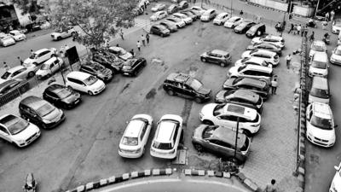

Slide 6
Problem statement
Inefficient parking lot allocation. Users are sometime forced to go around in Circles to find empty parking space, which then lead to traffic delays as more cars starts coming in the parking lot.
The old system is inconvenient in situations where customers an out of coupons and was not able to buy coupons through the provided outlets. The old coupons also canr with an inconvenient time-limit, where users are forced with a fixed time limit of 30 minutes per coupon. This is inconvenient for users who wishesto park for a short amount of time only as they cannot avoid paying for a coupon worth 30 minutes of parking time instead of having option to choose less time
The old system does not guarantee in providing accurate information for the Council or the service provider on how well the parking lots are utilized on hourly or daily basis. There is also no way of knowing if the coupons were used correctly by the 11K)torists and whether the parking attendant has been diligent in monitoring the proper usage of these coupons as they are not properly tracked.

Slide 7
Project scope
This project is mainly focused on simplifying and making the parking process in cities.This project will help civilians specifically the motorists and drivers to track whether a parking space is occupied or not. A website mobile online payment method is to enable users to pay for the parking space easily. The below shows the example of test bed parking system based on 10T with deployment of sensors to detect presence and absence of vehicle at the parking slot.

Slide 8
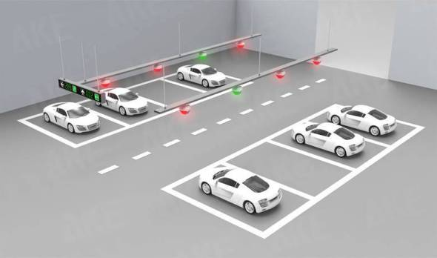
Scope

Slide 9
Objectives
There are three main goals for this project, which are:
l) To develop an online website booking parking spot.
2) To design and implement a system that can help the user to search for an available parking lot in real time using mobile web application. 3) TO design a system that connected to onsite deploy sensors to detect availability parking space.

Slide 10
Methodology
Methodology is an application roach consisted of a proven set of tools and techniques which can be application lied on a wide variety of projects by providing a roadmap for organizing a project from the beginning until the end of the project. In this project, I prefer to use Rapid Application Development (RAD) application roach. RAD application roach puts less emphasis on planning and emphasises more in project process. RAD divides the process into four phases which are analysis, prototype cycle, testing and deploy.

Slide 11
Analysis phase
In this first phase, a project planning and project analysis will be carried out. Project requirement will be identified in this phase. Feedback from users will be taken to be analysed and processed.

Slide 12
Prototype cycles
Moving to the second phase, the user feedbacks are gathered to determine the project’s architecture. In this phase, three repetitive cycle is included and an initial modelling will be created which includes flowchart layouts, Data Flow Diagram (DFD), and others.

Slide 13
Testing phase
In the third phase, most of the actual application coding, testing, and integration will take place. Testing phase is necessary in this phase where the accuracy of the project will be examined to see whether the project meets the requirements or not.

Slide 14
Deployment phase
The last phase is the implementation and full-scale testing of the project. After that, the project will be delivered and evaluated.

Slide 15
Significane of project
This project is expected to provide a friendly parking environment that will save user’ s money, helps reduce time consumption on paying for the parking, and ultimately resolve and reduce traffic delays around the Kuching Public area parking.

Slide 16
Expected outcome
There are a few expected outcomes for this project. The main outcome is a working and efficient parking system for parking space allocation that helps user to search for a free spot and ultimately reduces traffic delays. Next the project is also hoped to able to provide an accurate and systematic system which can help parking attendants and service providers to identify and keep track the vehicles and their owners.

Slide 17
Project report outline
Introduction — Introduction and background of Parking System based on IOT. Literature review — Literature review for existing systems. Requirement Analysis & Design — Methodology and design for the IOT based car parking system are discussed.
Implementation — Development and implementation of the proposed prototype.
Testing — Testing of the developed prototype will be carried out and result will recorded.
Limitation and Future Work — Discuss on the conclusion of the whole project along with the suggestion of possible improvement in the future of this project.

Slide 18
Summary
To conclude, an IOT based Smart Parking System is designed to utilizing the advantage of the IOT device. The combination of Smart and 10T technologies is used to make the Parking system be rmre efficient and meet the requirement of Human Centric Technology development, Moreover. The methodology used for system development is Rapid Application Development. Lastly, this system is more convenient and efficient compared to the convention or manual parking system.

Slide 19
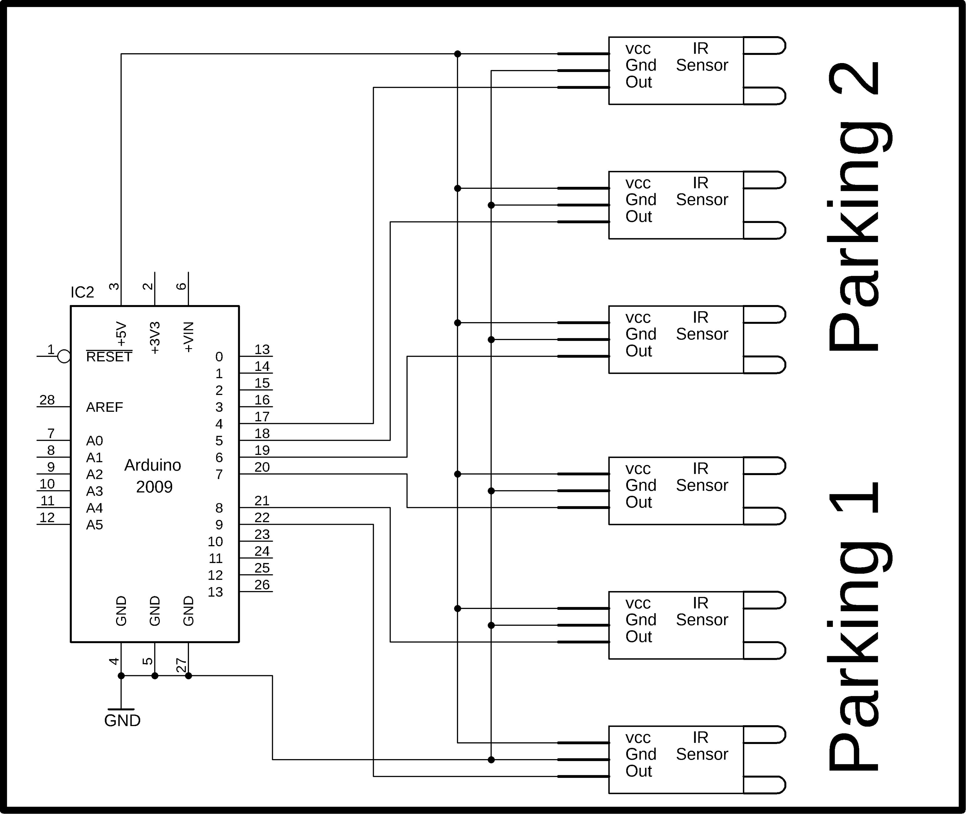
Thank you 😊

